Slide 1
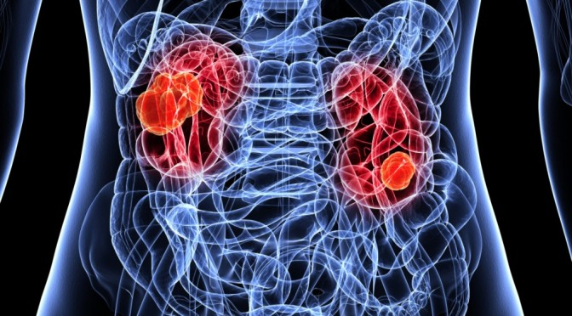
topic05 team02 kidney cancer
project proposal

Slide 2
Research question
Identification of kidney cancer drugs
Notes:
drug repurposing?
General benefits

Slide 3
Steps and to-do‘s
Data cleanup
Removing missing values or Imputing missing values
Is there any loss of information if we condense prism to prism.drug.means?
Removing low variance columns/rows
Re-ordering rows/columns in meaningful and useful ways ✓
Data exploration
basic exploratory data analysis (distribution of the overall data, specific samples or features) ✓
Visualize the data distribution ✓
Is there a mode of action which is more represented?
Visualize the inter-dependencies among specific samples/features of interest
Correlation between gene expression & copy number & treatment effect
Check some of your hypothesis like - is something high/low between two conditions etc
Identification of thresholds
Identification of housekeeping /tumor supressor genes

Slide 4
Next steps
Data reduction
Try out methods to reduce the dimensionality of this data
Cluster your samples to identify similar and dis-similar groups
Check how well the groups separate based on the features of your interesting
Data modelling

Slide 5
Milestones and timetable
Data cleanup
cleaned data set
Data exploration
Visualization of data distribution
Data reduction
cluster of samples
Data modelling
project presentation
Until 17.05. 23.05. 7.06. 28.06. 19.07.

Slide 6
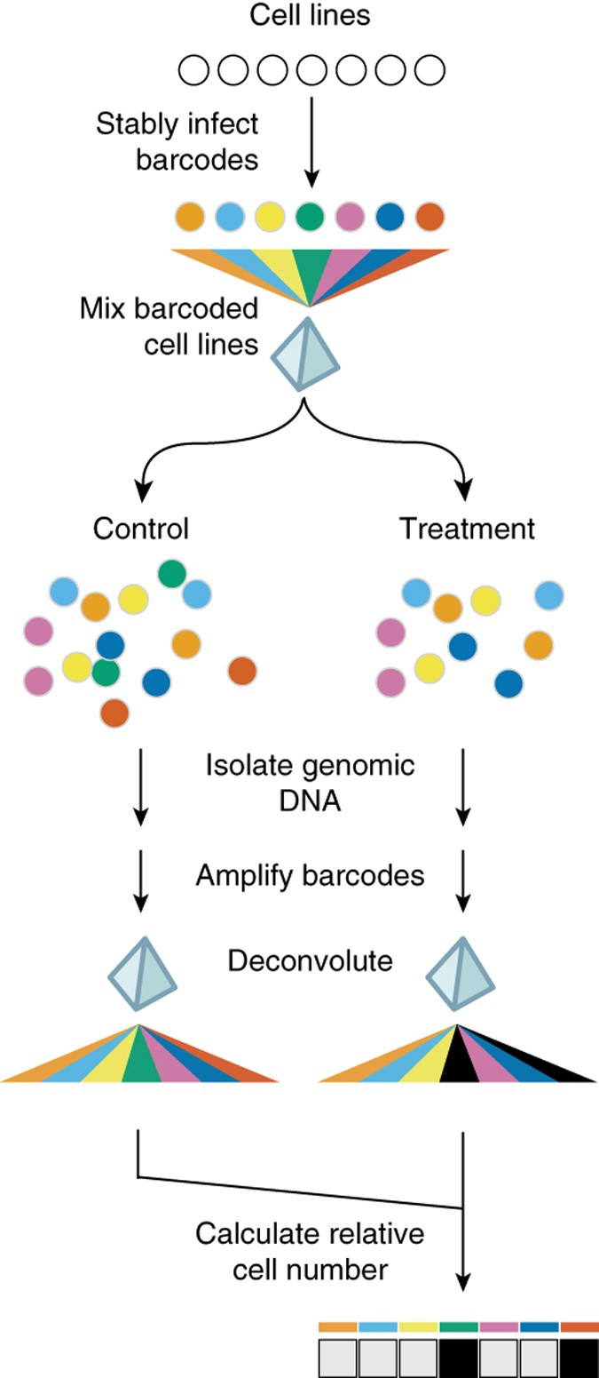
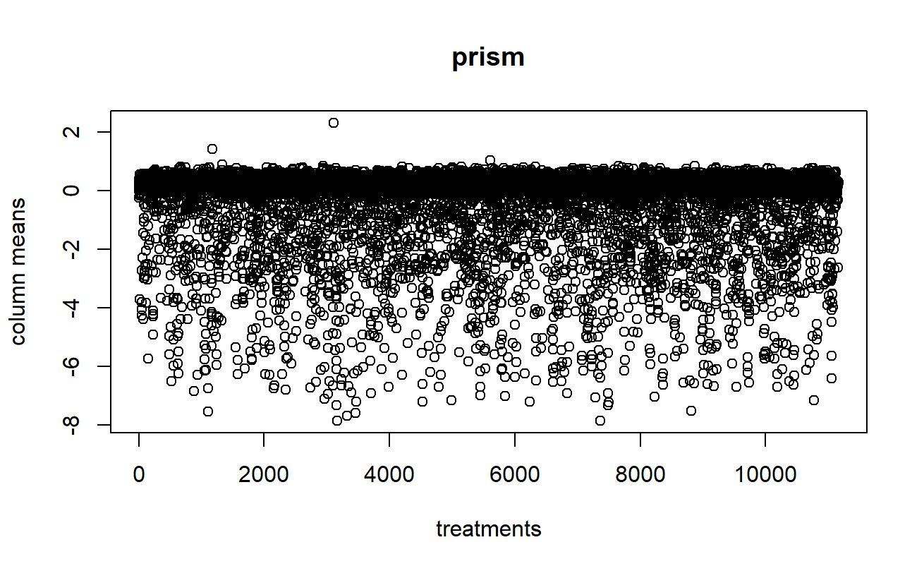
prism
 | treatment
Cell lines | Effect of treatment on cell growth
Notes:
24-base-pair DNA barcodes encoded within lentiviruses are stably integrated into individual tumor cell lines after blasticidin selection,
barcoded cell lines are individually frozen and later thawed to
generate mixtures of equal numbers of barcoded cell lines, which are frozen again.
Thawed mixtures are plated and then rearrayed into tissue culture assay plates.
Mixtures are treated with test compounds or vehicle (DMSO) controls.
At assay conclusion, genomic DNA is harvested from the mixture of remaining viable cells.
Barcode sequences are amplified using PCR and universal primers (one of which is biotinylated), and
amplified sequences are hybridized to individual microbeads harboring antisense barcode sequences and then to streptavidin-phycoerythrin.
A Luminex FlexMap detector quantitates fluorescence signal for each bead.
To adjust for differing barcoding efficiencies and differing cell doubling, the signal for each barcoded cell line is scaled to that of vehicle-treated control, thus demonstrating relative inhibition profiles for specific test compounds across multiple cell lines in mixture.

Slide 7
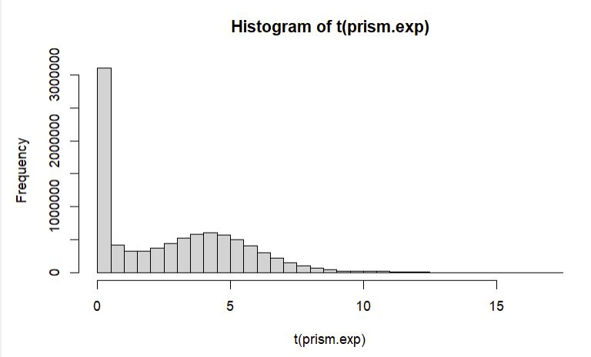
prism.exp
 | genes
Cell lines | Transcripts per million

Slide 8
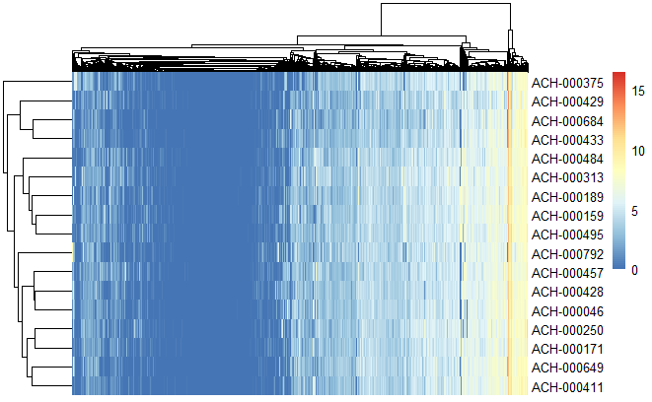
prism.exp.kidney
 | genes
Kidney Cell lines | Transcripts per million

Slide 9
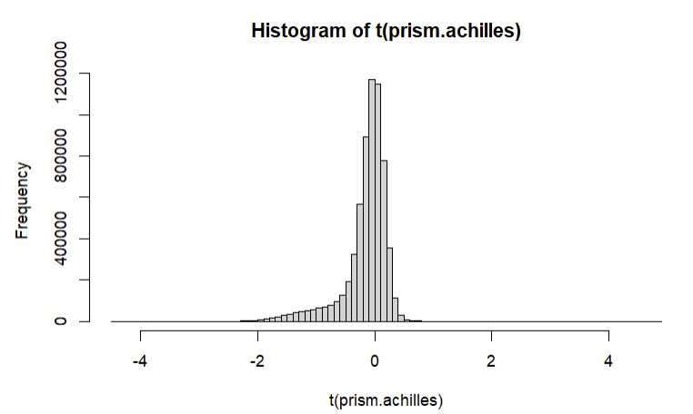
prism.achilles
 | genes
Cell lines | Gene knockout-scores

Slide 10
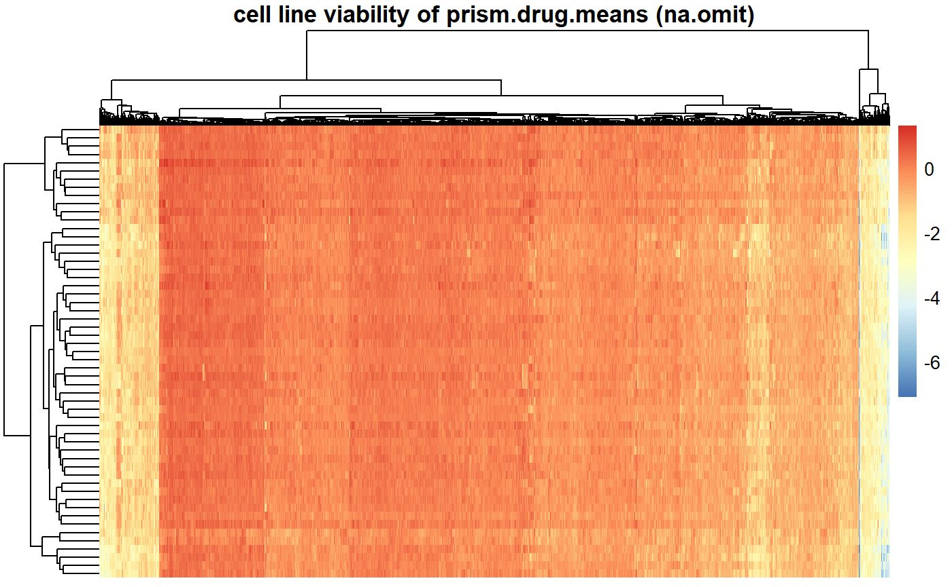
prism.drug.means
 | Treatment mean
Cell lines

Slide 11
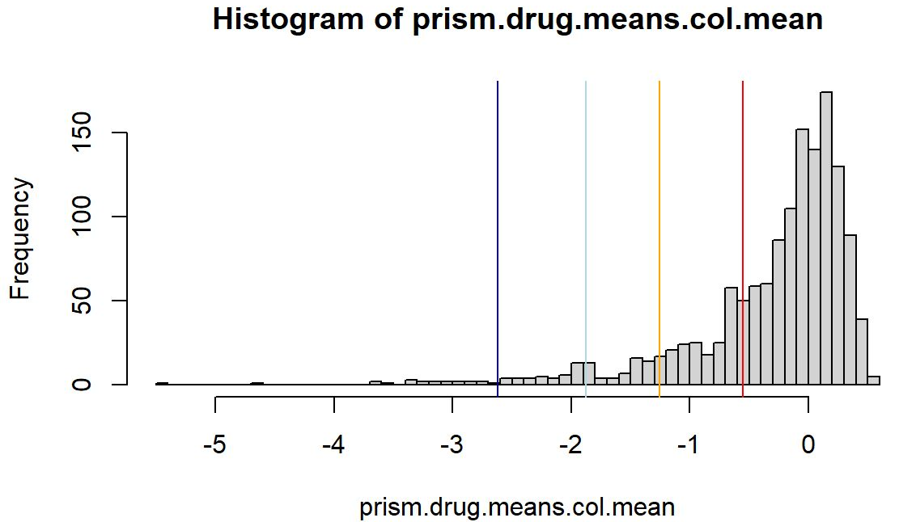
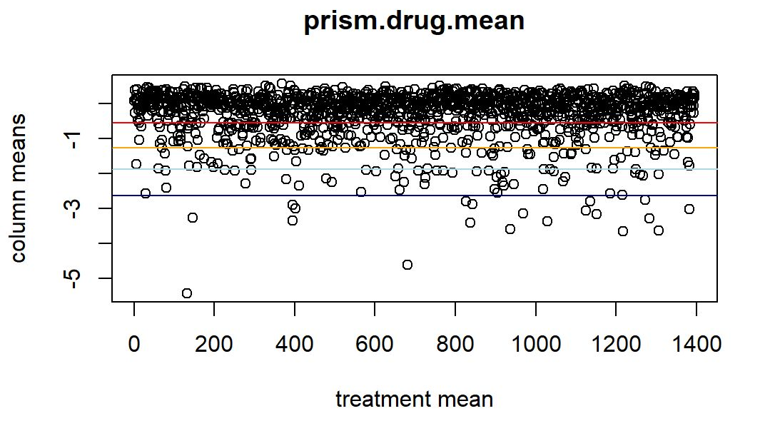
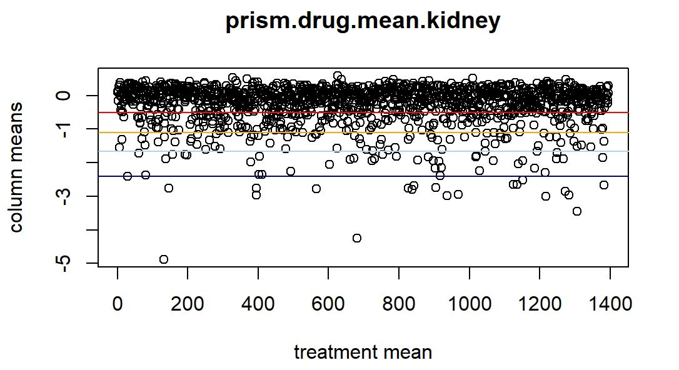
prism.drug.means
 | Treatment mean
Cell lines

Slide 12
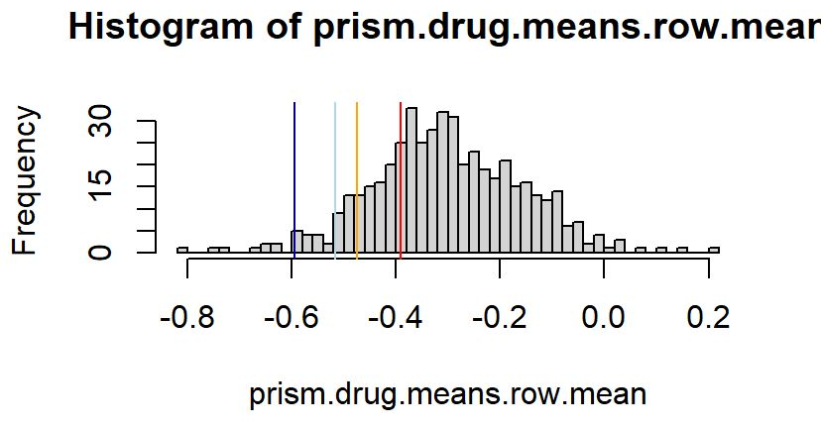
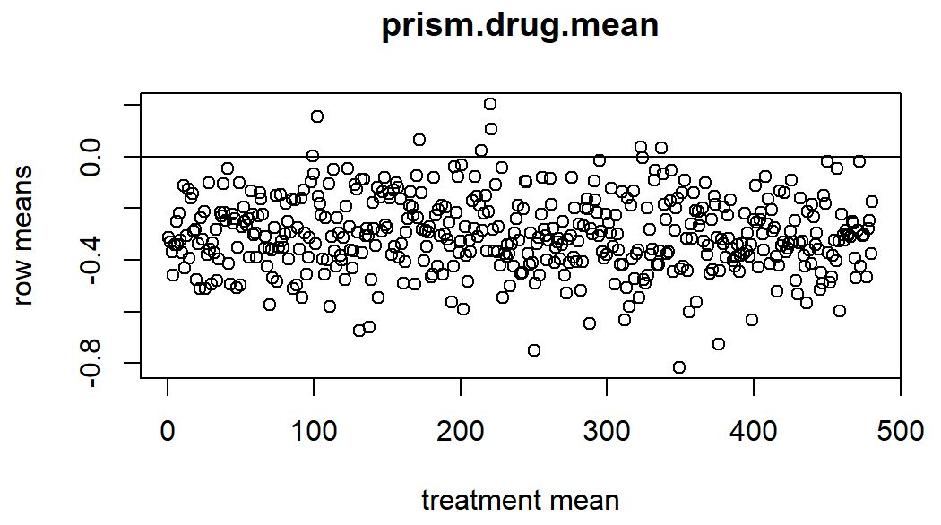
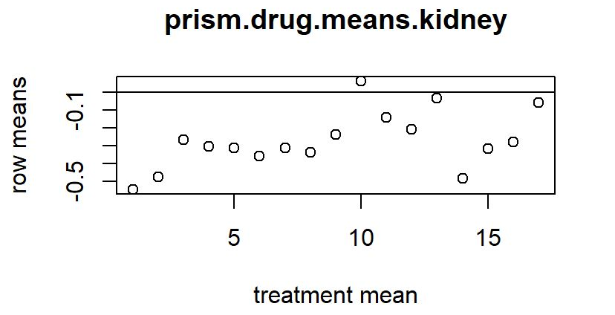
prism.drug.means
 | Treatment mean
Cell lines

Slide 13
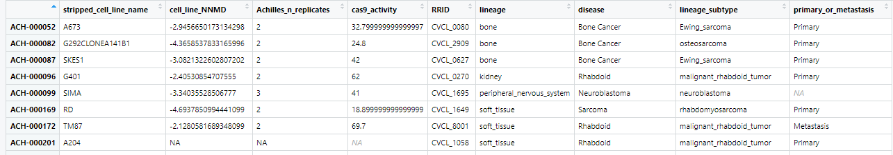
prism.cl
cell line informations

Slide 14
prism.cnv
 | genes
Cell lines | Copy number

Slide 15
"Dieses Foto" von Unbekannter Autor ist lizenziert gemäß CC BY

